Slide 1

ARM Processor Model
Lecture 2
Introduction to ARM Processor
This material is developed by IMTSchool for educational use only
All copyrights are reserved

Slide 2

ARM Cortex M3/M4 Processor Model
NVIC
Fetching Circuit
Instruction Decoder
ALU
Register File
Debug System
Memory Protection Unit
System Tick Timer

Slide 3
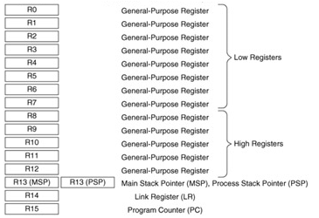

Register File

Slide 4
General Purpose Registers
R0
R1
R2
R3
R4
R5
R6
R7
These registers are used for data operations
Registers from R0 to R7 are called Low Level Registers because they are represented only by 3 bits ( 0 To 7 ). Therefor they are used mainly by the 16 bit instructions
Registers from R8 to R12 are called High Level Registers because they are represented by 4 bits. All of the 32 bit instructions can access these registers while Few of the 16 bit instructions can access these registers.
The initial value of these registers are not defined !
Low Level Registers
R8
R9
R10
R11
R12
High Level Registers

Slide 5
Stack Pointer R13
Physically there are 2 stack pointers, Main Stack Pointer MSP and Process Stack Pointer PSP. The R13 is pointing to one of them.
R13
MSP
PSP
Control [1] = 0
Control [1] = 1
MSP is the default stack pointer, the processor uses it by default after reset.
Changing the stack the pointer is done by changing bit 1 in the control register.
The processor uses the MSP always when executing the exception handler.

Slide 6
Link Register R14
It stores the return information for function calls and exceptions. On reset, the processor sets the LR value to 0xFFFFFFFF.
Branch(B) vs Branch With Link(BL) :
Example
The Cortex-M architecture supports two similar instructions: B and BL.
B Instruction allows the user to branch to an instruction that does not immediately follow the current instruction without saving any information about the current address.
BL Instruction saves the address of the instruction immediately following the BL command into the Link Register (R14). By storing the address of the next instruction into the link register, a function can “return” by moving the contents of the LR back into the PC using the BX (Branch and Exchange) command.
/*
Some Code 1
*/
Func();
/*
Some Code 2
*/
LR <- address of 1st instruction in code2
PC <- address of 1st instruction in Func
Func
PC <- LR

Slide 7
Assembly Example
void main (void)
void func (void)
; main assembly program
;********************
__main PROC
; Initialize R0
MOV R0, #0x01
; Call the function
BL __func
;Loop forever
B __main
ENDP
; func assembly program
;********************
__func PROC
;Check if R0 equals 1 or not ;and save 0 or 1 to R1
TST R0, #0x01
MOVEQ R1, #0
MOVNE R1, #1
; Return from the function
BX LR
ENDP

Slide 8
Program Counter R15
The Program Counter (PC) is register R15. It contains the current program address. On reset, the processor loads the PC with the value of the reset vector, which is at address 0x00000004.
Processor Reset Sequence:
Reset Handler
After reset, the PC is loaded by 0x00000000 by hardware
Processor saves the value of the address 0x00000000 to the MSP then jump to the reset handler
The instruction in the reset handler is a jump instruction to the startup code
0x00000000
0x20008000
0x00000004
0x20001000
Jump to Startup Code
0x20001000
Start up Instruction 1
0x20001004
Start up Instruction 2
Jump to main function
0x2000FF00
Application Instruction 1
0x2000FF04
Application Instruction 2
N.B. All addresses in Blue are for example

Slide 9
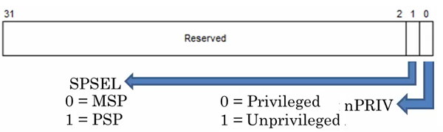
Control Register
The CONTROL register controls the stack used and the privilege level for software execution when the processor is in Thread mode.

Slide 10
Processor Operating Modes
Power On
“ Reset “
Handler
Exception
Privileged
Control [0] = 0
Control [0] = 1
Exception
Unprivileged
Control [0] = 1

Slide 11
Assembly Examples
Example 1
; Write 1 to Control register to enable all interrupts
MOV R0, #1
MSR CONTROL, r0
Example 2
; Write 0 to Control register to enable all interrupts
MOV R0, #0
MSR CONTROL, r0

Slide 12
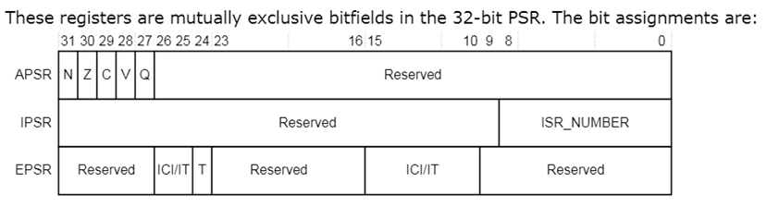
Program Status Word xPSR
The Processor Status Word (xPSR) combines 3 registers:
  Application Program Status Register (APSR)
  Interrupt Program Status Register (IPSR )
  Execution Program Status Register (EPSR)

Slide 13
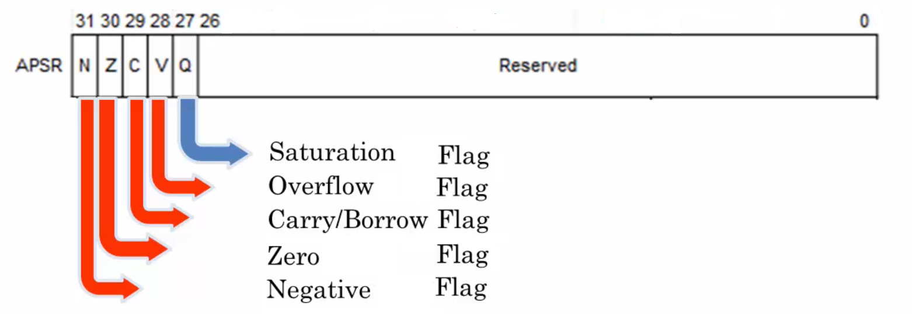
Application Program Status Register
The Application Program Status Register APSR contains the status flags of the integer operations ( N, Z, C, V and Q ) resulted from the previous instruction execution.

Slide 14
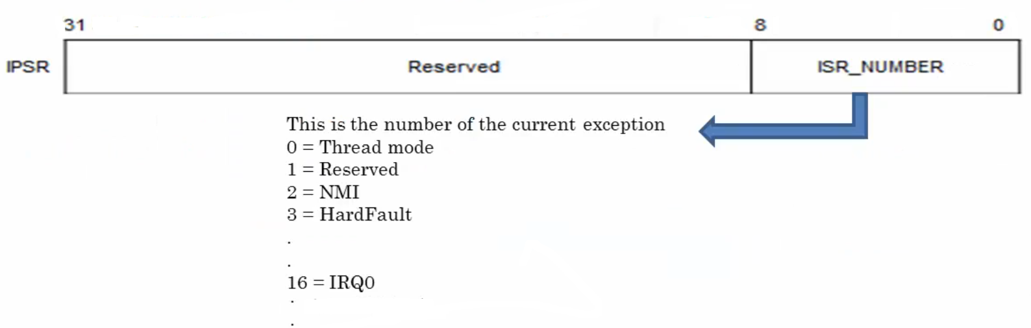
Interrupt Program Status Register
The Interrupt Program Status Register IPSR contains index of the current executing exception.

Slide 15
Execution Program Status Register
The Execution Program Status Register EPSR is giving information about the execution state of the processor. It contains the following bits:
  The Thumb state bit which indicate the current used instruction set. In our case it should be always 1 because we have only one instruction set (Thumb 2).
  Interruptible Continuable Instruction (ICI).
  IF-Then Instruction
When an interrupt occurs during the execution of an LDM or STM instruction, the processor:
• Stops the load multiple or store multiple instruction operation temporarily
• Stores the next register operand in the multiple operation to EPSRbits[15:12].
After servicing the interrupt, the processor:
• Returns to the register pointed to by bits[15:12]
• Resumes execution of the multiple load or store instruction.
When the EPSR holds ICI execution state, bits[26:25,11:10] are zero.

Slide 16
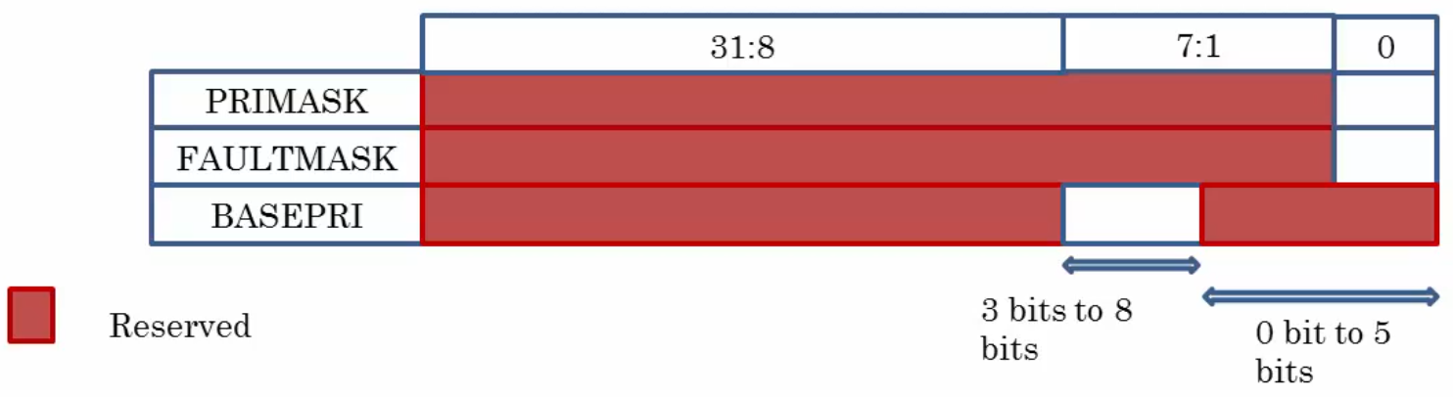
Exception Masking Registers
These three registers are used to mask interrupts.
To access the exception mask registers use the MSR and MRS instructions, or the CPS instruction to change the value of PRIMASK or FAULTMASK.

Slide 17
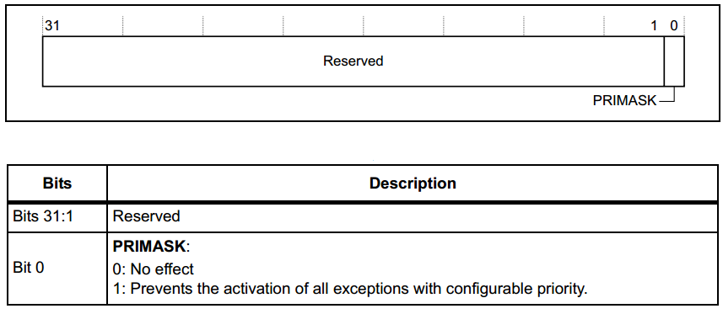
Priority Mask Register
The PRIMASK register prevents activation of all exceptions with configurable priority. It disables all interrupts have a priority more than or equals to 0. It is used to disable all exceptions except Reset, NMI and hard fault.

Slide 18
Assembly Examples
Example 1
; Clear PRIMASK (Enable interrupts)
CPSIE I
; Set PRIMASK (Disable interrupts)
CPSID I
Example 2
; Write 0 to PRIMASK to enable all interrupts
MOV R0, #0
MSR PRIMASK, R0
; Write 1 to PRIMASK to disable all interrupts
MOV R0, #1
MSR PRIMASK, R0
Notes:
CPS -> Change Processor State
Flags -> IE -> Interrupt Enable
ID -> Interrupt Disable
MSR -> Move from gpR to Special Register
MRS -> Mover from Special Register to gpR

Slide 19
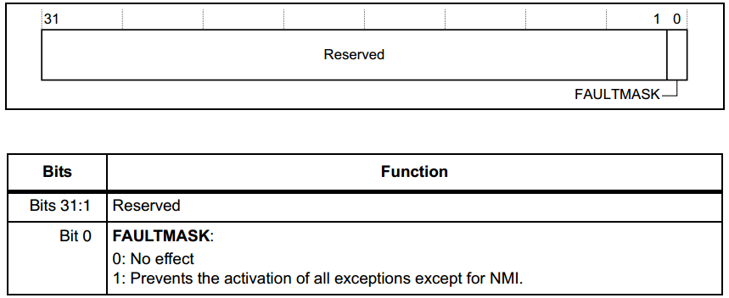
Fault Mask Register
The FAULTMASK disables all interrupts have a priority more than or equals to -1. It is used to disable all exceptions except Reset and NMI.

Slide 20
Assembly Examples
Example 1
; Clear FAULTMASK (Enable interrupts)
CPSIE F
; Set FAULTMASK (Disable interrupts)
CPSID F
Example 2
; Write 0 to FAULTMASK to enable all interrupts
MOV R0, #0
MSR FAULTMASK , R0
; Write 1 to FAULTMASK to disable all interrupts
MOV R0, #1
MSR FAULTMASK , R0

Slide 21
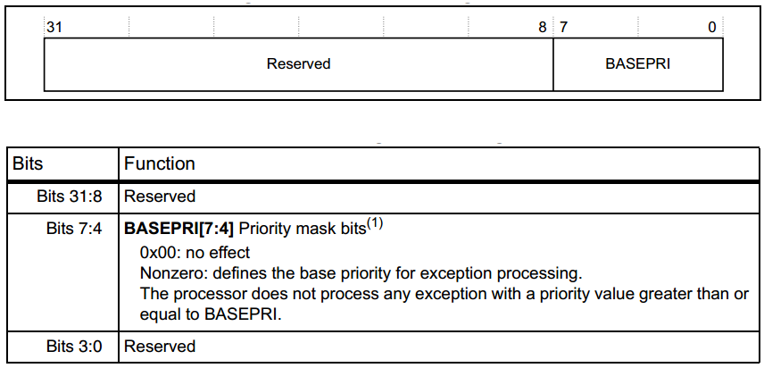
Base Priority Mask Register
The BASEPRI register defines the minimum priority for exception processing. When BASEPRI is set to a nonzero value, it prevents the activation of all exceptions with the same or lower priority level as the BASEPRI value.

Slide 22
Assembly Examples
Example 1
; Disable interrupts with priority 0x60-0xFF
MOV R0, #0x60
MSR BASEPRI, R0
Example 2
;Turn off BASEPRI masking
MOV R0, #0x0
MSR BASEPRI, R0

Slide 23
Register File Summery
Name | Type | Privilege | Reset Value
R0-R12 | RW | Either | Unknown
MSP | RW | Privileged | See description
PSP | RW | Either | Unknown
LR | RW | Either | 0xFFFFFFFF
PC | RW | Either | See description
PSR | RW | Privileged | 0x01000000
ASPR | RW | Either | Unknown
IPSR | RO | Privileged | 0x00000000
EPSR | RO | Privileged | 0x01000000
PRIMASK | RW | Privileged | 0x00000000
FAULTMASK | RW | Privileged | 0x00000000
BASEPRI | RW | Privileged | 0x00000000
CONTROL | RW | Privileged | 0x00000000

Slide 24


www.imtschool.com
ww.facebook.com/imaketechnologyschool/
This material is developed by IMTSchool for educational use only
All copyrights are reserved

